Slide 1

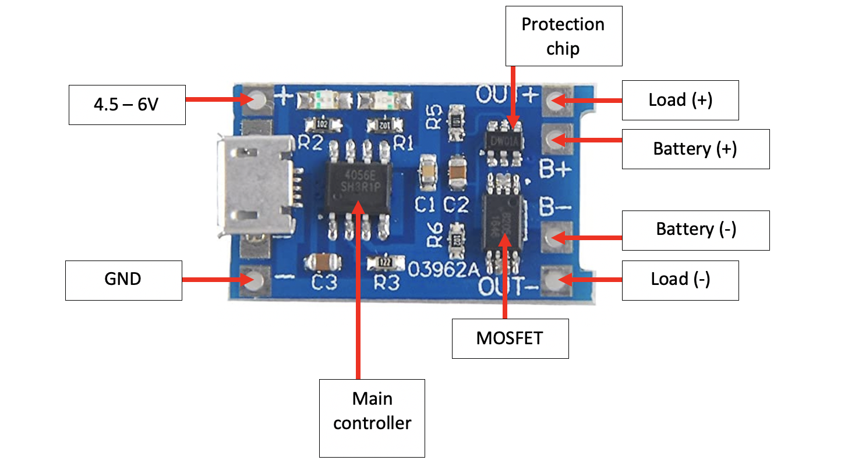

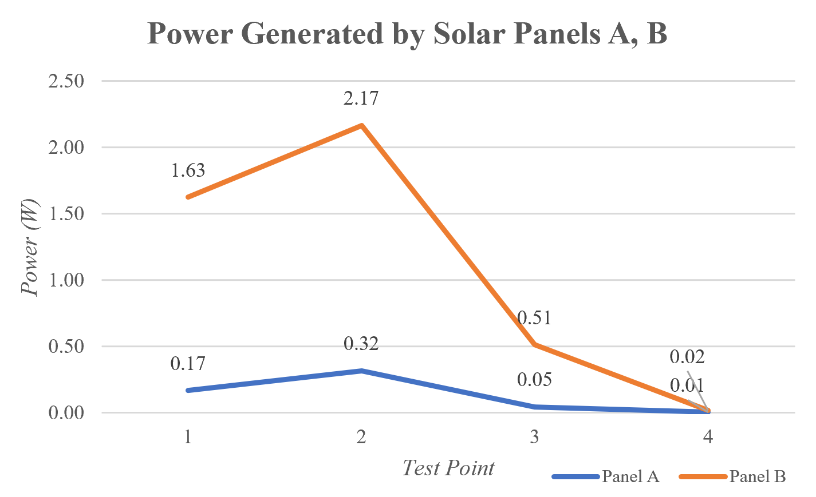
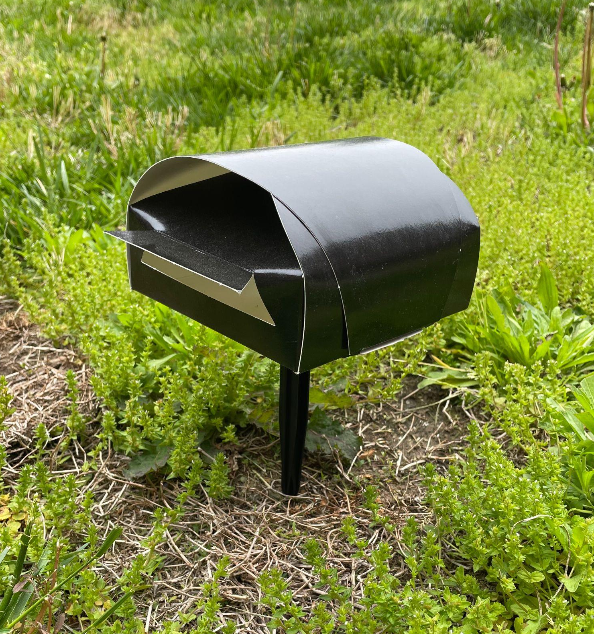
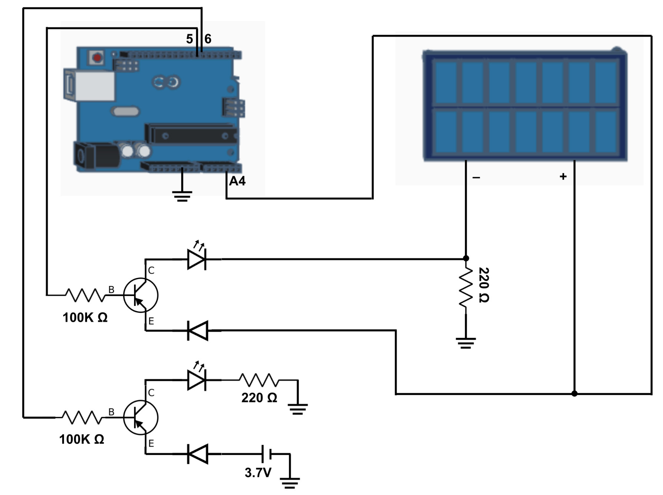
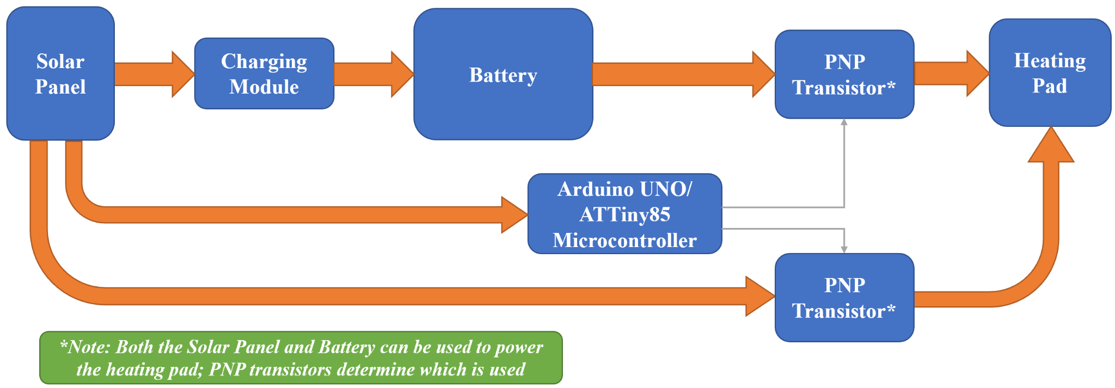
Solar-Powered Mosquito Trap
Madeline Chabab, Amanda Fernandes, Huanying (Joy) Yeh, and Carl Urbanik
Department of Electrical & Computer Engineering
Johns Hopkins University
Abstract
Solar Charging
Timing Mechanisms
The purpose of this project is to design a microprocessor-based electronic control circuit for a solar-powered mosquito trap. The trap attracts mosquitoes with a heatable semiconductor fabric and chemical compounds with scents attractive to mosquitoes. Once inside of the cardboard box, insecticides kill the mosquitos. This device may be deployed to developing countries in Africa and Asia, focusing on the Aedes aegypti and Anopheles gambiae mosquito species.
In order to charge the lithium-ion batteries, a circuit that acts as a charging module and battery protection unit is needed. A charging circuit must be incorporated to prevent the Li-ion battery from discharging below 2.4V, safely charge the battery to 4.2V, and limit the output of the battery if the discharge rate exceeds 3A.
With the Aedes aegypti and Anopheles gambiae mosquito species being most active between 2-3 prior to a day’s sunset and 2-3 hours before sunrise, the heating pad should only be on between these hours. To account for changing sunset and sunrise times throughout the year, the device records each day’s sunset time and uses this data to continuously update the period in which the heating pad should be on/off.
The mosquito trap currently utilizes timing functionalities from the Arduino Uno, but NE555 or LM555 timers may also be viable options for timekeeping. For commercial applications, a real-time clock or a quartz timer would be a highly accurate and consistent timing mechanism.
The device must be able to withstand a wide range of climates. The trap must also be able to operate independently from the power grid. It may be used to control and surveil the population of mosquitos that carry deadly diseases, such as malaria. The mosquito trap is being designed to be as durable, affordable, and simple as possible.
Charging Module Photo Source: MakerFocus Website
https://www.makerfocus.com/products/10pcs-tp4056-charging-module-5v-micro-usb-1a-18650-lithium-battery-charging-board
Testing & Results
Extensive testing was required for power system design, specifically to determine appropriate devices for solar power generation and storage of that power. Comparative tests were conducted to select a solar panel that would collect ample current to power the system without being too large to be supported by the box and stake structure (shown below in “Next Steps”).
Figure 3: Charging Module
Microcontroller Selection
For the mosquito trap to remain compact, inexpensive, but still autonomous, a small and simple microcontroller must be used. Microcontroller specification research, along with programming trials, concluded in the selection of the ATtiny85 as a microcontroller. This chip provides the EEPROM and I2C capabilities required for autonomous control of the mosquito trap while being compact and cost-effective. To configure the ATtiny85 and for testing purposes prior to programming the ATtiny85, an Arduino UNO was utilized.
One such power study compared power levels achieved by two different solar panels, one measuring 4.05x4.05 cm (panel A) and the other 10.64x12.07 cm (panel B). The study’s results, shown in the plot to the right, led to our selection of panel B for preliminary designs.
Figure 1: World Map showing
Death Rate from Malaria
Introduction
Based on environmental data and mosquito behavior, the heating pad shall be turned on from about 2 hours before sunset to about 3 o’clock in the morning. The desired heating pad temperature for the heating pad is about 2°C above ambient temperature. It, combined with insecticides, can lure and kill mosquitoes.
Figure 5: Solar Panel Power Analysis
Power Source Switching Circuit
Next Steps
The control challenge is the combination of two power sources: a battery and a solar panel. The lithium-ion battery shall charge during the day with the solar panel and power the trap at night.
Based on the sunlight available, the mosquito trap will switch between solar power and battery power. For example, the heating pad will primarily draw power from the battery during the dark nighttime hours. But in the hours just before sunset when the heating pad should be on, there may be ample sunlight to bypass the battery and draw power directly from the solar panel. The circuit to control this power switching is shown below.
One priority in the next phase of this project is to equip the device to run for extended periods of time. A higher storage capacity may be needed for the timing mechanism to function properly alongside the other controller processes.
System Design
Additionally, a custom charging module will need to be sourced or manufactured to support battery charging with the solar panels this device employs. The power levels currently being produced by the onboard solar panel are too low for compatibility with most commercial charging modules.
Finally, once the electronic system nears completion, it should be fitted to mount compactly onto the foldable box and stake structure shown to the right.
A system-level one-line diagram is shown below, depicting interconnections from initial solar energy collection to powering of the heating pad. Through using a minimal amount of inexpensive and easily-sourceable components,
the design aims to minimize cost, size, and complexity of the system.
Figure 6: Box & Stake Structure
Additional Questions?
Madeline Chabab: mchabab1@jhu.edu
Amanda Fernandes: aferna44@jhu.edu
Huanying Yeh: hyeh9@jhu.edu
Carl Urbanik: curbani1@jhu.edu
Figure 2: System-level One-Line Diagram
Figure 4: Wiring Schematic of Power Source Switching Circuit

